Slide 1

Data Structures(15B12CI311)
ODD 2021
Fibonacci Heaps
Jaypee Institute of Information Technology (JIIT)
A-10, Sector 62, Noida

Slide 2
FIBONACCI HEAPS

Slide 3
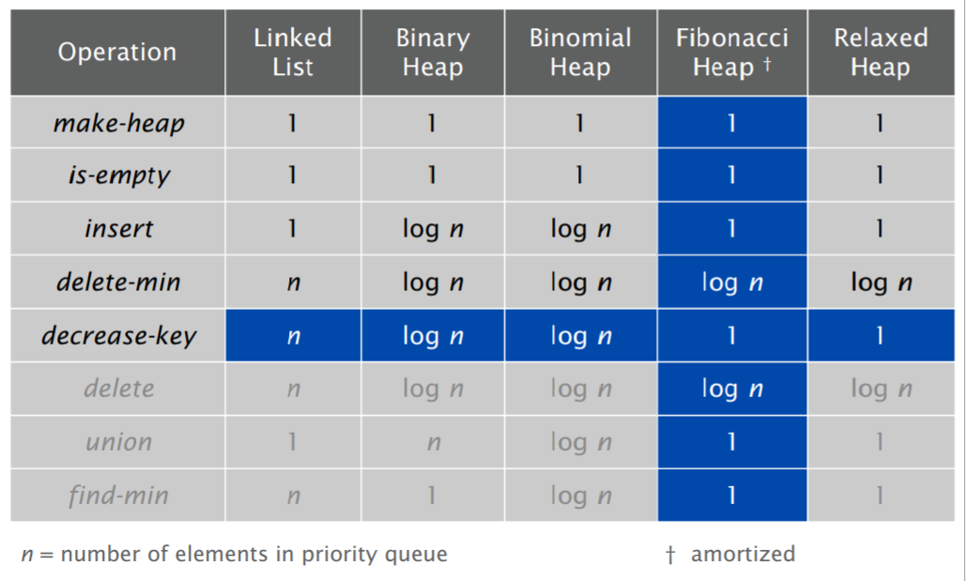
Amortized time complexities of Fibonacci Heap.
Amortized Analysis is used for algorithms where an occasional operation is very slow, but most of the other operations are faster. In Amortized Analysis, we analyze a sequence of operations and guarantee a worst case average time which is lower than the worst case time of a particular expensive operation.

Slide 4
Fibonacci Heaps
Basic idea.
Similar to binomial heaps, but less rigid structure.
Binomial heap: eagerly consolidate trees after each insert.
Fibonacci heap: lazily defer consolidation until next delete-min.

Slide 5
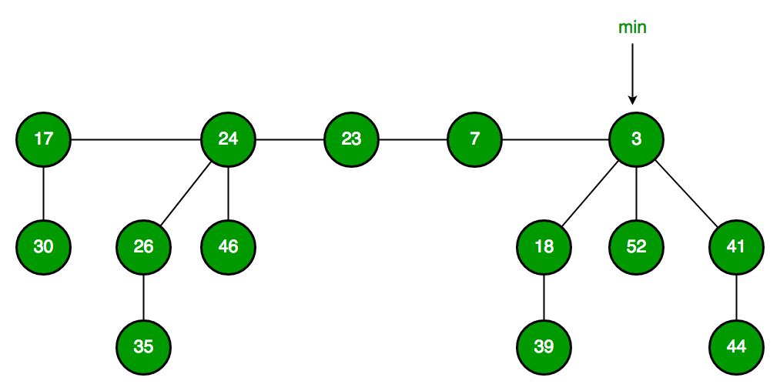
Fibonacci Heap
Collection of trees with min-heap or max-heap property.
Trees can have any shape even all trees can be single nodes (This is unlike Binomial Heap where every tree has to be Binomial Tree).
Maintains a pointer to minimum value (which is root of a tree).
All tree roots are connected using circular doubly linked list, so all of them can be accessed using single ‘min’ pointer.

Slide 6
The main idea is to execute operations in “lazy” way.
For example:
merge operation simply links two heaps,
insert operation simply adds a new tree with single node.
The operation extract minimum is the most complicated operation. It does delayed work of consolidating trees.
This makes delete also complicated as delete first decreases key to minus infinite, then calls extract minimum.

Slide 7
Fibonacci Heaps: Structure
Fibonacci heap.
Set of min-heap ordered trees.
min
17
24
23
7
3
30
26
46
marked
18
52
41
35
44
H
39
Notes:
set -> unordered

Slide 8
Fibonacci Heaps: Implementation
Implementation.
Represent trees using left-child, right sibling pointers and circular, doubly linked list.
Roots of trees connected with circular doubly linked list.
fast union
Pointer to root of tree with min element.
fast find-min
17
24
23
7
3
min
30
26
46
18
52
41
35
44
H
39

Slide 9
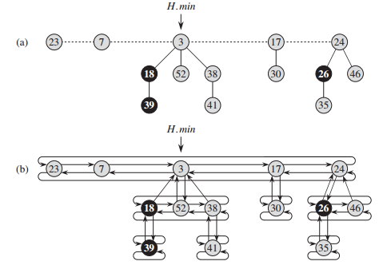
DETAILED REPRESENTATION
Represent trees using left-child, right sibling pointers and circular, doubly linked list.
Roots of trees connected with circular doubly linked list.

Slide 10
Operations on Fibonacci Heap

Slide 11
Fibonacci Heaps: Insert
Insert.
Create a new singleton tree.
Add to left of min pointer.
Update min pointer.
Insert 21
21
min
17
24
23
7
3
30
26
46
18
52
41
35
44
H
39

Slide 12
Fibonacci Heaps: Insert
Insert.
Create a new singleton tree.
Add to left of min pointer.
Update min pointer.
Insert 21
min
17
24
23
7
21
3
30
26
46
18
52
41
35
44
H
39

Slide 13
Fibonacci Heaps: Insert
Insert.
Create a new singleton tree.
Add to left of min pointer.
Update min pointer.
Running time. O(1)
Insert 21
min
17
24
23
7
21
3
30
26
46
18
52
41
35
44
H
39

Slide 14
Fibonacci Heaps: Union
Union.
Concatenate two Fibonacci heaps.
Root lists are circular, doubly linked lists.
min
min
23
24
17
7
3
21
H'
H''
30
26
46
18
52
41
35
44
39

Slide 15
Fibonacci Heaps: Union
Union.
Concatenate two Fibonacci heaps.
Root lists are circular, doubly linked lists.
Running time. O(1)
min
23
24
17
7
3
21
H'
H''
30
26
46
18
52
41
35
44
39

Slide 16
Linking Operation : will be used in delete min
Linking operation. Make larger root be a child of smaller root.
larger root
smaller root
still heap-ordered
15
3
3
56
24
18
52
41
15
18
52
41
77
39
44
56
24
39
44
tree T₁
tree T₂
77
tree T'

Slide 17
Fibonacci Heaps: Delete Min
Delete min.
Delete min and concatenate its children into root list.
Consolidate trees so that no two roots have same degree.
min
7
24
23
17
3
30
26
46
18
52
41
35
39
44

Slide 18
Fibonacci Heaps: Delete Min
Delete min.
Delete min and concatenate its children into root list.
Consolidate trees so that no two roots have same degree.
current
min
7
24
23
17
18
52
41
30
26
46
39
44
35

Slide 19
Fibonacci Heaps: Delete Min
Delete min.
Delete min and concatenate its children into root list.
Consolidate trees so that no two roots have same degree.
0
1
2
3
current
min
7
24
23
17
18
52
41
30
26
46
39
44
35

Slide 20
Fibonacci Heaps: Delete Min
Delete min.
Delete min and concatenate its children into root list.
Consolidate trees so that no two roots have same degree.
0
1
2
3
current
min
7
24
23
17
18
52
41
30
26
46
39
44
35

Slide 21
Fibonacci Heaps: Delete Min
Delete min.
Delete min and concatenate its children into root list.
Consolidate trees so that no two roots have same degree.
0
1
2
3
min
7
24
23
17
18
52
41
30
26
46
39
44
current
35

Slide 22
Fibonacci Heaps: Delete Min
Delete min.
Delete min and concatenate its children into root list.
Consolidate trees so that no two roots have same degree.
0
1
2
3
min
7
24
23
17
18
52
41
30
26
46
39
44
current
35
Merge 17 and 23 trees.

Slide 23
Fibonacci Heaps: Delete Min
Delete min.
Delete min and concatenate its children into root list.
Consolidate trees so that no two roots have same degree.
0
1
2
3
current
min
7
24
17
18
52
41
30
26
46
23
39
44
35
Merge 7 and 17 trees.

Slide 24
Fibonacci Heaps: Delete Min
Delete min.
Delete min and concatenate its children into root list.
Consolidate trees so that no two roots have same degree.
0
1
2
3
min
current
24
7
18
52
41
26
46
17
30
39
44
35
23
Merge 7 and 24 trees.

Slide 25
Fibonacci Heaps: Delete Min
Delete min.
Delete min and concatenate its children into root list.
Consolidate trees so that no two roots have same degree.
0
1
2
3
min
current
7
18
52
41
24
17
30
39
44
26
46
23
35

Slide 26
Fibonacci Heaps: Delete Min
Delete min.
Delete min and concatenate its children into root list.
Consolidate trees so that no two roots have same degree.
0
1
2
3
min
current
7
18
52
41
24
17
30
39
44
26
46
23
35

Slide 27
Fibonacci Heaps: Delete Min
Delete min.
Delete min and concatenate its children into root list.
Consolidate trees so that no two roots have same degree.
0
1
2
3
min
current
7
18
52
41
24
17
30
39
44
26
46
23
35

Slide 28
Fibonacci Heaps: Delete Min
Delete min.
Delete min and concatenate its children into root list.
Consolidate trees so that no two roots have same degree.
0
1
2
3
min
current
7
18
52
41
24
17
30
39
44
26
46
23
Merge 41 and 18 trees.
35

Slide 29
Fibonacci Heaps: Delete Min
Delete min.
Delete min and concatenate its children into root list.
Consolidate trees so that no two roots have same degree.
0
1
2
3
min
current
7
52
18
24
17
30
41
39
26
46
23
44
35

Slide 30
Fibonacci Heaps: Delete Min
Delete min.
Delete min and concatenate its children into root list.
Consolidate trees so that no two roots have same degree.
0
1
2
3
min
current
7
52
18
24
17
30
41
39
26
46
23
44
35

Slide 31
Fibonacci Heaps: Delete Min
Delete min.
Delete min and concatenate its children into root list.
Consolidate trees so that no two roots have same degree.
min
7
52
18
24
17
30
41
39
26
46
23
44
Stop.
35

Slide 32
Fibonacci Heaps: Delete Min Analysis
Delete min.
Actual cost. O(rank(H)) + O(trees(H))
O(rank(H)) to meld min's children into root list.
O(rank(H)) + O(trees(H)) to update min.
O(rank(H)) + O(trees(H)) to consolidate trees.
Also, trees(H' ) ≤ rank(H) + 1 since no two trees have same rank.
Amortized cost. O(rank(H)) = O(log n)
Notes:
if no decrease-key, our data structure is a lazy version of a binomial queue
decrease key will not preserve property that all trees are binomial trees, but it will be close enough to bound maximum degree by O(log n)

Slide 33
Fibonacci Heaps: Decrease Key
Decrease key of element x to k.
Marked Node: A node is marked to indicate that it has lost a single child and a node is unmarked if it loses no children.
Case 0: min-heap property not violated.
decrease key of x to k
change heap min pointer if necessary
min
7
18
38
24
17
23
21
39
41
26
46
45
30
52
Decrease 46 to 45.
35
88
72

Slide 34
Fibonacci Heaps: Decrease Key
Decrease key of element x to k.
Case 1: parent of x is unmarked.
decrease key of x to k
cut off link between x and its parent
mark parent
add tree rooted at x to root list, updating heap min pointer
min
7
18
38
24
17
23
21
39
41
26
45
15
30
52
Decrease 45 to 15.
35
88
72

Slide 35
Fibonacci Heaps: Decrease Key
Decrease key of element x to k.
Case 1: parent of x is unmarked.
decrease key of x to k
cut off link between x and its parent
mark parent
add tree rooted at x to root list, updating heap min pointer
min
7
18
38
24
24
17
23
21
39
41
26
15
30
52
Decrease 45 to 15.
35
88
72

Slide 36
Fibonacci Heaps: Decrease Key
Decrease key of element x to k.
Case 1: parent of x is unmarked.
decrease key of x to k
cut off link between x and its parent
mark parent
add tree rooted at x to root list, updating heap min pointer
min
15
7
18
38
72
24
24
17
23
21
39
41
26
30
52
Decrease 45 to 15.
35
88

Slide 37
Fibonacci Heaps: Decrease Key
Decrease key of element x to k.
Case 2: parent of x is marked.
decrease key of x to k
cut off link between x and its parent p[x], and add x to root list
cut off link between p[x] and p[p[x]], add p[x] to root list
If p[p[x]] unmarked, then mark it.
If p[p[x]] marked, cut off p[p[x]], unmark, and repeat.
min
15
7
18
38
72
24
24
17
23
21
39
41
26
30
52
Decrease 35 to 5.
35
88
5

Slide 38
Fibonacci Heaps: Decrease Key
Decrease key of element x to k.
Case 2: parent of x is marked.
decrease key of x to k
cut off link between x and its parent p[x], and add x to root list
cut off link between p[x] and p[p[x]], add p[x] to root list
If p[p[x]] unmarked, then mark it.
If p[p[x]] marked, cut off p[p[x]], unmark, and repeat.
min
15
5
7
18
38
72
24
24
17
23
21
39
41
parent marked
26
30
52
Decrease 35 to 5.
88

Slide 39
Fibonacci Heaps: Decrease Key
Decrease key of element x to k.
Case 2: parent of x is marked.
decrease key of x to k
cut off link between x and its parent p[x], and add x to root list
cut off link between p[x] and p[p[x]], add p[x] to root list
If p[p[x]] unmarked, then mark it.
If p[p[x]] marked, cut off p[p[x]], unmark, and repeat.
min
15
5
26
7
18
38
88
24
72
24
17
23
21
39
41
parent marked
30
52
Decrease 35 to 5.

Slide 40
Fibonacci Heaps: Decrease Key
Decrease key of element x to k.
Case 2: parent of x is marked.
decrease key of x to k
cut off link between x and its parent p[x], and add x to root list
cut off link between p[x] and p[p[x]], add p[x] to root list
If p[p[x]] unmarked, then mark it.
If p[p[x]] marked, cut off p[p[x]], unmark, and repeat.
min
15
5
26
24
7
18
38
72
88
17
23
21
39
41
30
52
Decrease 35 to 5.

Slide 41
Fibonacci Heaps: Decrease Key Analysis
Actual cost. O(c)
O(1) time for changing the key.
O(1) time for each of c cuts, plus melding into root list.
Amortized cost. O(1)

Slide 42
Fibonacci Heaps: Delete
Delete node x.
decrease-key of x to -∞.
delete-min element in heap.
Amortized cost. O(rank(H))/ O(log n)
O(1) amortized for decrease-key.
O(rank(H))/ O(log n ) amortized for delete-min.

Slide 43
Priority Queues Performance Cost Summary
Operation
Linked List
Binary Heap
Binomial Heap
Fibonacci Heap †
Relaxed Heap
make-heap
1
1
1
1
1
is-empty
1
1
1
1
1
insert
1
log n
log n
1
1
delete-min
n
log n
log n
log n
log n
decrease-key
n
log n
log n
1
1
delete
n
log n
log n
log n
log n
union
1
n
log n
1
1
find-min
n
1
log n
1
1
n = number of elements in priority queue
† amortized
Notes:
main improvement: decrease-key is now O(1)
we'll emphasize the first 5 ops

Slide 44
Lecture slides adapted from:
Chapter 20 of Introduction to Algorithms by Cormen, Leiserson, Rivest, and Stein.
Chapter 9 of The Design and Analysis of Algorithms by Dexter Kozen
https://www.geeksforgeeks.org/fibonacci-heap-set-1-introduction/
https://www.cs.princeton.edu/~wayne/teaching/fibonacci-heap.pdf
http://staff.ustc.edu.cn/~csli/graduate/algorithms/book6/chap21.htm

